Slide 1

Loop Statements (Part1)
Asst. Prof. Dr. Derya BİRANT

Slide 2
OUTLINE
Loop Statements
  While - loop
  Do while - loop
  For – loop
Choosing a Loop
Examples

Slide 3
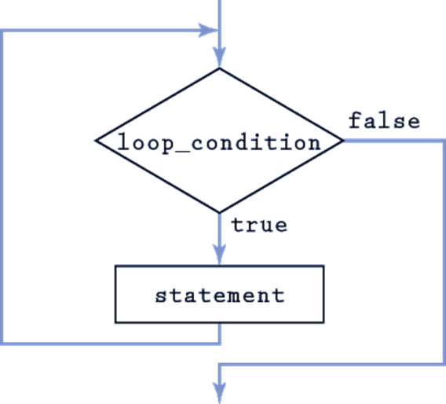
Loop Statements
Loops permit statement(s) to be executed repeatedly

Slide 4
Loop Example
Start
counter=1
Write counter
counter = counter +1
counter
!=100?
True
False
End

Slide 5
Loop Example
Loop Statement Components
  Control variable (loop counter)
  Initial value of the control variable
  Execute statement(s)
  Increment/decrement of control variable through each loop
  Loop-condition that tests for the final value of the control variable
counter = 1
statement
counter = counter +1
counter
!=100?
True
False

Slide 6
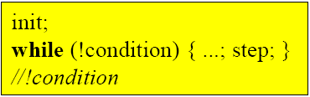
while Statement
Repeats an action while its loop-condition remains true
init
F
condition
T
statement
step

Slide 7
while Statement
Repetition continues so long as condition is true!
Start
int i=1;
while (i <= 10)
{
Console.Write(" " + i);
i = i + 1;
}
counter=1
Write counter
counter = counter +1
1 2 3 4 5 6 7 8 9 10
counter
<=10?
True
False
End

Slide 8
while Statement
int i=1;
while (i <= 10)
{
Console.Write(" " + i);
i = i + 2;
}
1 3 5 7 9

Slide 9
while Statement
Find the total of the numbers between 1 and 10
int i = 1;
int sum = 0;
while (i <= 10)
{
sum = sum + i;
i = i + 1;
}
Console.WriteLine(sum);
i | sum
1 | 0
1 | 1
2 | 3
3 | 6
4 | 10
5 | 15
6 | 21
7 | 28
8 | 36
9 | 45
10 | 55
11 | 55
55

Slide 10
while Statement
Find the total of given 5 numbers
int i=1;
int sum = 0;
int number;
while (i <= 5)
{
number=Convert.ToInt16(Console.ReadLine());
sum = sum + number;
i = i + 1;
}
Console.WriteLine(sum);
i | number | sum
1 | ? | 0
1 | 14 | 14
2 | 3 | 17
3 | 9 | 26
4 | 6 | 32
5 | 2 | 34
6 | 2 | 34
34

Slide 11
while Statement
Write a program that finds the count of positive numbers within given 15 numbers.
int i=1;
int count = 0;
int number;
while (i <= 15)
{
number = Convert.ToInt16(Console.ReadLine());
if (number > 0)
count = count + 1;
i = i + 1;
}
Console.WriteLine(count);

Slide 12
while Statement
Find the average of given numbers until number is taken as -1
int number;
double sum = 0;
int count = 0;
Console.WriteLine("Enter a number");
number = Convert.ToInt16(Console.ReadLine());
while (number != -1)
{
sum = sum + number;
count = count + 1;
number = Convert.ToInt16(Console.ReadLine());
}
Console.WriteLine("The result = " + sum/count);

Slide 13
do while Statement
while statement
  Performs the actions in its body zero or more times
do…while statement
  Performs the actions in its body one or more times
int i = 0;
while (i < 5) {
...
i++;
}
int i = 0;
do {
...
i++;
}
while (i < 5);
iteration with test at the begin of the loop
iteration with test at the end of the loop
(first pass always executed)

Slide 14
do while Statement
int i=1;
while (i <= 10)
{
Console.Write(" " + i);
i = i + 1;
}
1 2 3 4 5 6 7 8 9 10
int i=1;
do
{
Console.Write(" " + i);
i = i + 1;
} while (i <= 10);
1 2 3 4 5 6 7 8 9 10

Slide 15
do while Statement
int i=20;
while (i <= 10)
{
Console.Write(" " + i);
i = i + 1;
}
int i=20;
do
{
Console.WriteLine(" " + i);
i = i + 1;
} while (i <= 10);
20

Slide 16
do while Statement
Write a program that finds the count of even numbers within given 10 numbers
int i=1;
int count = 0;
int number;
do
{
number = Convert.ToInt16(Console.ReadLine());
if (number % 2 == 0)
count = count + 1;
i = i + 1;
} while (i <= 10);
Console.WriteLine(count);

Slide 17
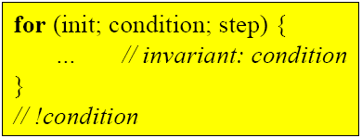
for Statement
for loop permits a statement to be executed repeatedly:
init
F
condition
T
statement
step

Slide 18
for Statement
The for loop is most commonly used to count from one value first to another value last:
for (int count = first; count <= last; count++)
Statement
count = first
F
count <= last
T
Statement
count++

Slide 19
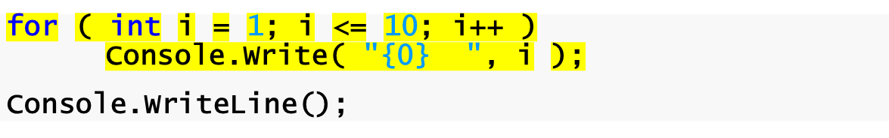
for Statement
Control-variable name is counter
Condition tests for counter’s final value
initial value is 1
Increment for counter
1 2 3 4 5 6 7 8 9 10

Slide 20
for Statement
Find the total of the numbers between 1 and 10
int i = 1;
int sum = 0;
while (i <= 10)
{
sum = sum + i;
i = i + 1;
}
Console.WriteLine(sum);
int sum = 0;
for (int i = 1; i <= 10; i++)
sum = sum + i;
Console.WriteLine(sum);
55

Slide 21
for Statement
Find the factorial of a given number
int n;
int facto = 1;
Console.WriteLine("Enter a number");
n = Convert.ToInt16(Console.ReadLine());
for (int i = 1; i <= n; i++)
facto = facto * i;
Console.WriteLine(facto);

Slide 22
for Statement
Write a program that calculates the result of x^{y}
int x, y, result = 1;
Console.WriteLine("Enter the base");
x = Convert.ToInt16(Console.ReadLine());
Console.WriteLine("Enter the exponent");
y = Convert.ToInt16(Console.ReadLine());
for (int i = 1; i <= y; i++)
result = result * x;
Console.WriteLine(result);

Slide 23
for Statement
A dice is rolled 18 times. Write a program that finds the count of each face of dice.
int bir=0, iki=0, uc=0, dort=0, bes=0, alti=0;
int face;
Random random = new Random();
for (int i = 1; i <= 18; i++)
{
face = random.Next(1, 7);
switch (face)
{
case 1:
bir = bir + 1;
break;
case 2:
iki = iki + 1;
break;
case 3:
uc = uc + 1;
break;
case 4:
dort = dort + 1;
break;
case 5:
bes = bes + 1;
break;
default:
alti = alti + 1;
break;
}
}
Console.WriteLine("bir = {0},
iki = {1}, uc = {2},dort = {3},bes = {4},altı = {5}“, bir, iki, uc, dort, bes, alti);

Slide 24
Summary
While – loop
  init; while (condition) { do something ; step}
Do while – loop
  init; do { something ; step } while (condition)
For – loop
  for (init; condition; step) { do something }

Slide 25
Choosing a Loop
With three loops, how do we know which one to use?
Design algorithms for non-counting problems using a general loop statement, and see where it is appropriate for repetition to terminate:
  If at the loop’s beginning, use the while loop
  If at its end, use the do loop
Use the for loop for counting problems.

Slide 26
Example
Write a program that finds the largest number within given 50 numbers.
int number;
int largest = -99999;
Console.WriteLine("Enter 50 numbers");
for (int i = 1; i <= 50; i++)
{
number = Convert.ToInt16(Console.ReadLine());
if (number > largest)
largest = number;
}
Console.WriteLine("The largest number is " + largest);

